Slide 1



P. R. Pote (Patil) College of Engineering & Management, Amravati (An Autonomous Institute) Department of Artificial Intelligence and Data Science
Presentation on
MediMatch: Smart Medicine Recommender
Presented By
Kasturi R. Bhogal (L)
Aman R. Kokate
Aditya S. Hire
Dnyaneshwari S. Bhagat
Nikhil V. Ingale
Guided By
Prof. P. J. Dembla
Year 2024-25

Slide 2
Abstract
MediMatch is a machine learning-based medicine recommendation system designed to suggest alternative medications with similar therapeutic effects. Utilizing TF-IDF vectorization and cosine similarity, the system processes a database of 841 medicines across various categories to identify suitable alternatives when prescribed medications are unavailable. With a modern, intuitive interface, users can easily search for medicines and access detailed information about recommended alternatives.

Slide 3

Introduction
MediMatch is a machine learning-driven project designed to recommend alternative medicines when prescribed ones are unavailable. By applying TF-IDF vectorization and cosine similarity on a curated dataset of 841 medicines, the system identifies therapeutically similar options. The recommendations are presented through a user-friendly web interface, enhancing accessibility and decision-making in healthcare.
.

Slide 4
Problem Statement
Challenges Faced by Patients :-
Unavailable medications due to stock shortages
High prices limiting affordability
Limited access to healthcare providers
How MediMatch Helps :-
Instantly suggests alternative medicines
Provides clear, detailed information for each option
Offers a simple, user-friendly interface
Includes buy links for fast access via online pharmacies

Slide 5
AIM & Objectives
Aim :-
To develop an intelligent web-based system that recommends alternative medicines based on user input, helping patients find similar therapeutic options when their prescribed medication is unavailable.
Objective :-
This project creates a detailed medicine database and uses machine learning to recommend alternatives based on therapeutic use. It features a user-friendly web interface with comprehensive drug info and supports integration with online pharmacies for easy purchases.

Slide 6
Literature Survey
Limitations of Existing Platforms :-
DrugBank & RxList lack alternative medicine recommendations
Pharmacy systems are often restricted to professionals
Most health apps focus only on reminders or basic info
Patient Needs & Insights
72% of patients struggle to find substitutes
Recommendation systems can boost treatment adherence by 68%
Effective Technologies :-
TF-IDF and Flask proven effective for building user-friendly suggesters

Slide 7
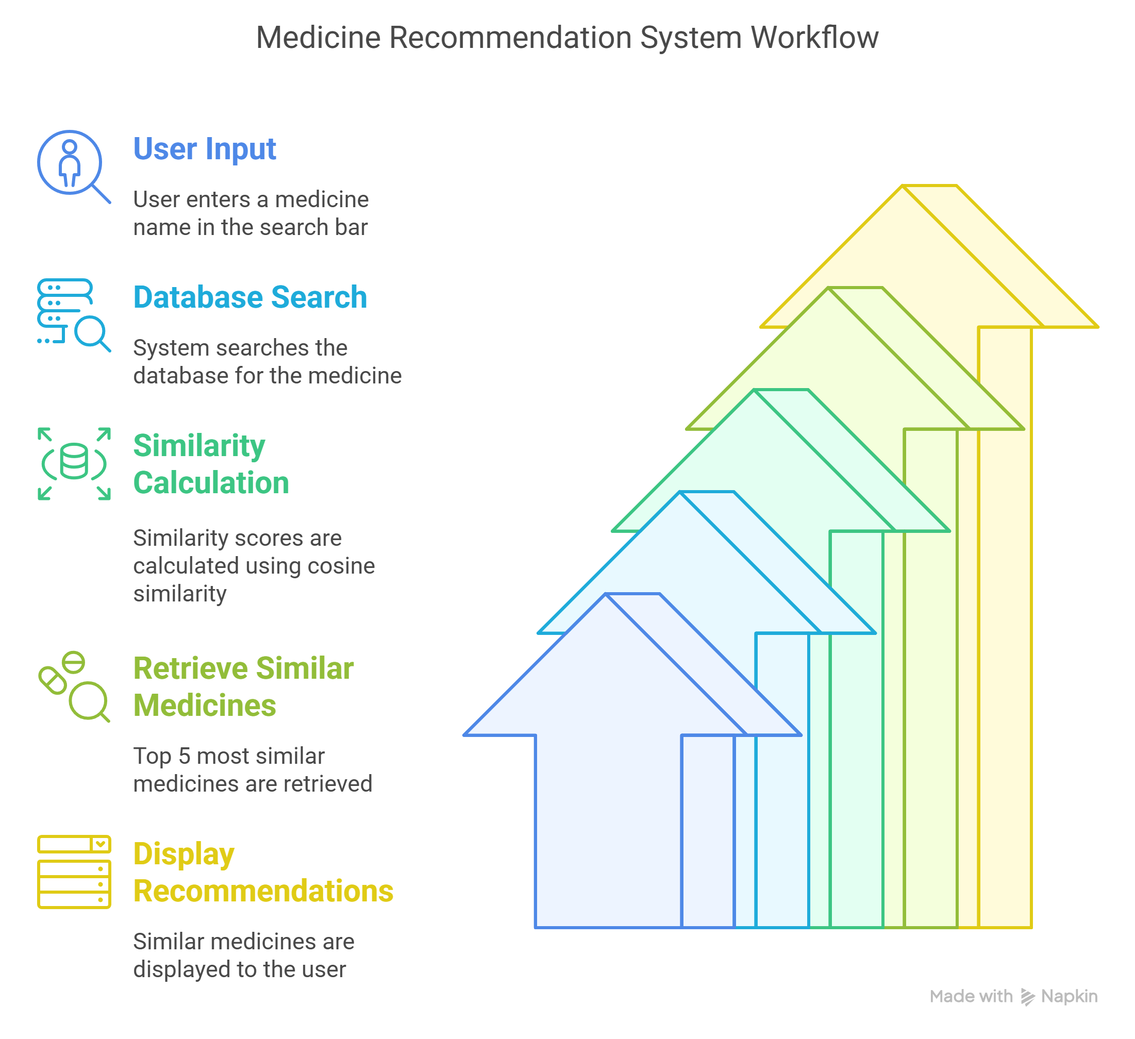
Idea / Methodology
All diagrams of proposed system

Slide 8
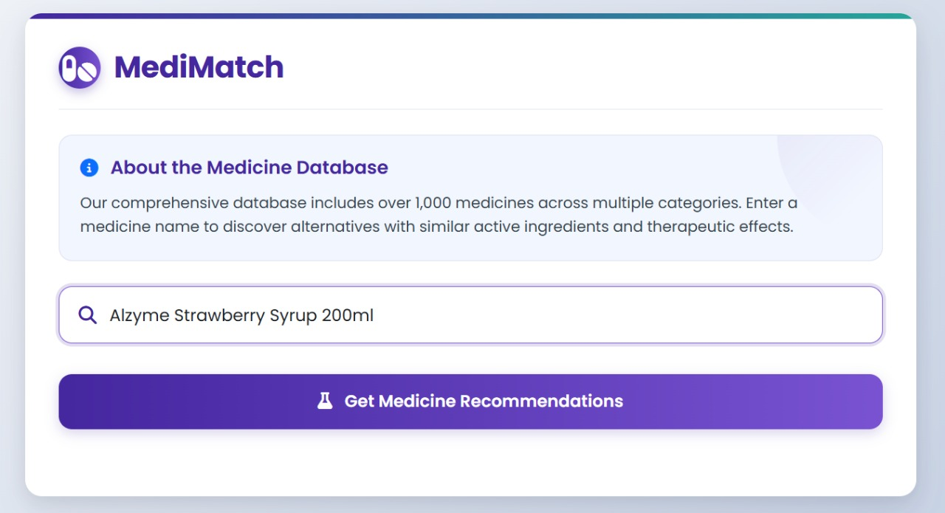
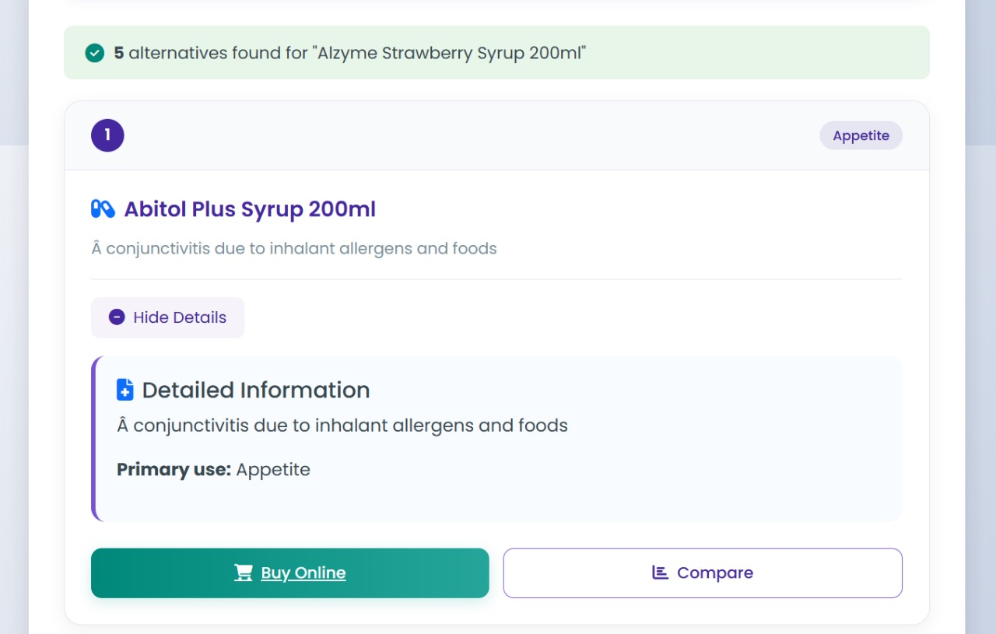
Screen shots/ Results

Slide 9
Result Analysis
Performance Summary:-
Accuracy: 87% relevant recommendations
Speed: 0.6s avg. response time
Key Insights:-
TF-IDF + cosine similarity gave best results
Pre-computed similarity matrix reduced response time by 78%
Flask ensured smooth performance

Slide 10
Opportunities and Challenges
Enhancements :-
E-prescription & healthcare system integration
Mobile app & multilingual support
Drug interaction alerts & symptom-based suggestions
Data Upgrades :-
More medicine categories
Pricing info & user reviews
Challenges :-
Accuracy for complex meds
Real-time updates & performance
User trust & digital literacy barriers

Slide 11
Conclusion
MediMatch Highlights :-
Uses TF-IDF + cosine similarity for accurate alternative medicine recommendations
Helps ensure treatment continuity during medicine unavailability
User-friendly interface simplifies access to complex medical data
Future Potential :-
Add drug interaction warnings
Enable symptom-based search
Impact:-
Supports digital healthcare transformation
Empowers users to make informed health decisions

Slide 12
References
Kumar et al. (2019):- Explored text vectorization techniques for analyzing medication similarity
Williams & Rodriguez (2020):- Studied the positive impact of recommendation systems on medication adherence
Aronson (2019):- Reviewed medication recommendation systems and future directions
Peterson & Nguyen (2022):- Compared TF-IDF vs. word embeddings in pharmaceutical text analysis
Pedregosa et al. (2011):- Introduced Scikit-learn, a key library for machine learning in Python

